Slide 1

Toward Super High-Level SDN Programming
Presenter: X. Tony Wang
Nov. 15, 2016

Slide 2
Background
Super computing can benefit from super efficient and super flexible infrastructures
Traditional networks are not flexible, leading to inefficient network resources usage
Emergence of SDN promises super efficient and flexible networks but current SDN control programming systems are low level, limited (the “machine-code” age…)
For more information, please contact us: supersdnprogramming@gmail.com
1
Notes:
It is very known that super computing can benefit from…
The current network component in super computing is not …

Slide 3
Issues in Current SDN Programming
Issue 1: Complex, manual project deployment
The state-of-the-art SDN controller is OpenDaylight, in OpenDaylight programming requires:
Handle project dependencies (feature.xml …)
Feature/Kar install in karaf console
•••
For more information, please contact us: supersdnprogramming@gmail.com
2
Notes:
Emergence of SDN promises super efficient and flexible networks but current SDN control programming systems are low level, limited (machine code age…)
1.Complex, split programming model
(OpenFlow is a low level, complex computation model: it does not even support logic negation, and hence needs priority to simulate logic negation, it supports only layer 2 to layer 4, but many decisions may depend on higher layers )
2.Network dynamics(Complex manual tracking of execution dependency Manual cleanup, re-execute)

Slide 4
Issues in Current SDN Programming
Issue 2: SDN programmers manually write openflow rules; openflow is a low level and limited computation model
Openflow does not support logic negation, and hence needs priority to simulate logic negation;
Openflow supports only layer 2 to layer 4, but many decisions depend on higher layers
For more information, please contact us: supersdnprogramming@gmail.com
3

Slide 5

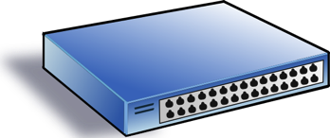

An Example: A Simple SDN Controller
Policy: block traffic to port 22
badPort = 22 // policy hostTbl = {A:1,B:2, C:3,D:4} // net view
def onPacketIn(p):
if badPort == p.tcp_dst: drop
else: forward([hostTbl(p.eth_dst)])
1
2
3
4
A
B
C
D
For more information, please contact us: supersdnprogramming@gmail.com
4
Notes:
We use a simple example to demonstrate the issue. Here the user wants to block all traffic to port 22…

Slide 6
Controller Program with Flow Table Management
hostTbl = {A:1,B:2,C:3,D:4}
def onPacketIn(p):
if 22 == p.tcp_dst: drop
installRule({‘match':{'tcp_dst':22}, ‘action’:[]})
else: forward([hostTbl(p.eth_dst)])
installRule({‘match’: {‘eth_dst’:p.eth_dst, ’tcp_dst’!=22},
‘action’:[hostTbl(p.eth_dst)]})
match does not support logic negation
For more information, please contact us: supersdnprogramming@gmail.com
5

Slide 7
Controller Program with Flow Table Management
hostTbl = {A:1,B:2,C:3,D:4}
def onPacketIn(p):
if 22 == p.tcp_dst: drop
installRule({‘priority’:1, ‘match’:{'tcp_dst':22}, ‘action’:[]})
else: forward([hostTbl(p.eth_dst)])
installRule({‘priority’:0, ‘match’: {‘eth_dst’:p.eth_dst},
‘action’:[hostTbl(p.eth_dst)]})
For more information, please contact us: supersdnprogramming@gmail.com
6

Slide 8
Does the Program Work?
Switch
EthDst:A,
TcpDst:80
{`priority`:0,’match’:{‘eth_dst’:A},'action':[1]}
EthDst:A,
TcpDst:22
A security bug!
Controller
def onPacketIn(p):
if 22 == p.tcp_dst: drop
installRule({`priority`:1,’match’:{‘tcp_dst':22},'action':[]})
else:
installRule({`priority`:0,’match’:{‘eth_dst’:p.eth_dst},
'action':[hostTbl(p.eth_dst)]})
forward([hostTbl(p.eth_dst)])
For more information, please contact us: supersdnprogramming@gmail.com
7
Notes:
Unfortunately, this program has a bug. To see where the program goes wrong, let’s watch what happens when we connect this controller to a single switch and let two packets arrive. Both packets have destination mac A. The red packet is to TCP destination 80, while the green packet is to TCP destination 22. When the red packet arrives, the switch has an empty flow table and sends the packet to the controller. The controller determines that the packet should be forwarded to the next hop, and installs the appropriate rule. The red packet returns to the switch and moves onward. Now, the port 22 packet arrives at the switch, and instead of being dropped or sent to the controller, it matches the low priority rule for Ethernet destination A and is therefore forwarded onward. This violates the user’s intentions and may represent a security violation.

Slide 9
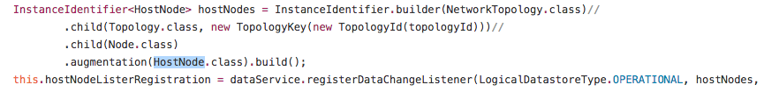
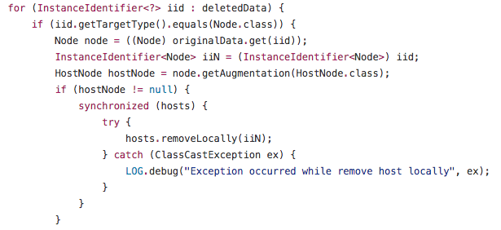
Issues in Current SDN Programming
Issue 3: SDN programmers use incremental programming
Need to manually setup listeners for data changes and handle data change events
Easy to introduce bugs
This code is from the l2switch project in ODL
For more information, please contact us: supersdnprogramming@gmail.com
9
Notes:
Emergence of SDN promises super efficient and flexible networks but current SDN control programming systems are low level, limited (machine code age…)
1.Complex, split programming model
(OpenFlow is a low level, complex computation model: it does not even support logic negation, and hence needs priority to simulate logic negation, it supports only layer 2 to layer 4, but many decisions may depend on higher layers )
2.Network dynamics(Complex manual tracking of execution dependency Manual cleanup, re-execute)

Slide 10
New SDN Programming Tools: Overview
User Space
MapleApp: A program written by java
Maple Lib: Read pkt fields, add route
Web SDN IDE: Deploy the project in one click and integrate multiple views
Control Space
Maple Runtime: Record the operations (read which fields) on packets and generates rules
FAST: Track runtime data dependence & re-execute when data changes happen
Network Information Base: Provide network state, southbound driver
Network
Openflow Switch
Openflow Switch
Openflow Switch
For more information, please contact us: supersdnprogramming@gmail.com
9
Notes:
Therefore, to resolve these issues, we designed a series of tools to simplify sdn control programming.
Control space

Slide 11
Web SDN IDE
Lightweight and portable
One-click app deployment
Simplify the project deployment process
Multiple views for development and operations
Developer’s view (Project, Network simulator, Debugging)
Operator’s view (Topology, Routes)
For more information, please contact us: supersdnprogramming@gmail.com
10

Slide 12
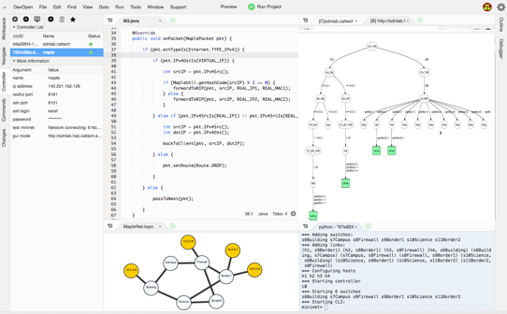
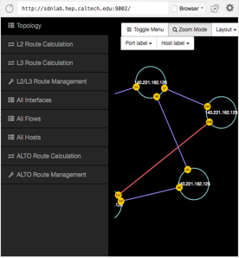
Web SDN IDE
Write Maple application
Check the TraceTree for debigging
Simplify the deployment process
Show topology
Check routes and flow tables
Connect to multiple controllers
Monitor controller state
Controller management
Automatically generate Mininet topology scripts
Network simulator
One-click deployment
Development and debugging
Topology and routes management
For more information, please contact us: supersdnprogramming@gmail.com
11
Notes:
This is the layout of the ide

Slide 13
Maple: High-level SDN Programming Language
Consider each pkt as a request
- Network as a single virtual server
- Network functions expressed in general purpose language
- Network functions (logically) invoked on each new pkt, returning how net handles that request
- Network decision can depend on L2 to L7
For more information, please contact us: supersdnprogramming@gmail.com
12
Notes:
To transfer application written by high-level language to low-level flow rules, we design the maple system. the maple system provides a per-packer …which conceptly process every-packet in the network.

Slide 14
Example
Control the traffic based on URI (a static path version)
1. private static final String[] H12_TAP = { H1, "openflow:1:2", "openflow:2:1" }​
2. private static final String[] H12_ONE = { H1, "openflow:1:2", "openflow:2:3", "openflow:4:1" }​
3. private static final String[] H12_TWO = { H1, "openflow:1:3", "openflow:3:2", "openflow:4:1" } ​
4.​void f(Packet pkt) {​
5. int srcIP = pkt.srcIP(); int dstIP = pkt.dstIP();​
6. String flowId = computeFlowId( srcIP, dstIP, pkt.srcPort, pkt.dstPort, pkt.protocol );​
7. if ( srcIP == H1 && dstIP == H2 ) {​
8. FlowMetadata fm = getFlowMetadata(flowId); ​
9. if ( fm == null ) { ​
10. pkt.addRoute( H12_TAP );​
11. pkt.addRoute( H12_ONE );​
12. } else if ( isVideo( getUri( fm ) ) ) {​
13. pkt.addRoute( H12_TWO );​
14. } else pkt.addRoute( H12_ONE );​
15. } else if ( srcIP == H2 && dstIP == H1 ) {​
16. …​
17. } else pkt.addRoute( Route.drop );​
18. }​
Per-packet
programming
model
Control packets with L7 info
South-band
agnostic
What if the data changes?
For more information, please contact us: supersdnprogramming@gmail.com
13
Notes:
Consider this maple application example which wants to …
Maple app is a lamda function which is not increment function. What if the data changes, … (introduce FAST)

Slide 15
FAST: Function Automation System
Hosting generic data-driven network functions
Easy-to-use programming paradigm
Automatic dependency management
Track fine-grained runtime dependency
Subscribe to data changes automatically
Enforced data consistency
Rollback outdated function instances
Re-execute to keep system state up to date
FAST
Add/Remove
Generic Network Function
Function Instance Store
State update
Listener sub
Network
Data Read/Write
Data Store
For more information, please contact us: supersdnprogramming@gmail.com
14
Notes:
…
…
When state changes, …

Slide 16
Summary
Complex, manual programming
Web IDE simplifies SDN programming, automatically deploying the programs, integrating different views (programs, topology, routes)
Low level, limited programming model
Maple provides high-level, per-packet, south-bound agnostic, cross-layer (L2-L7) programming
Complex data consistency management
FAST automatically tracks execution dependencies, re-executing functions when dependencies change
For more information, please contact us: supersdnprogramming@gmail.com
15

Slide 17
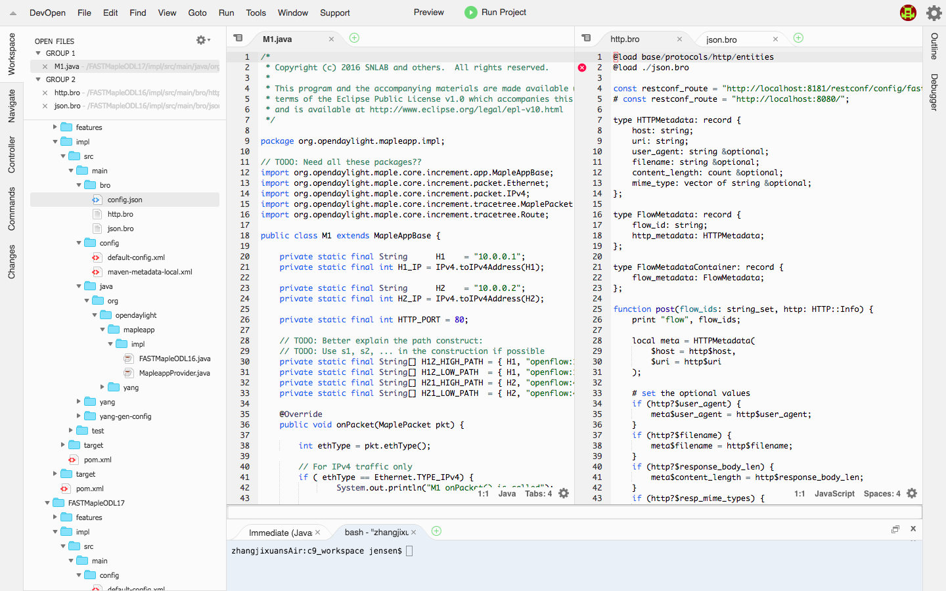
DEMO: Control Traffic based on HTTP Info
http.bro
MapleApp.java
Step of Demo:
Controller
1. User writes & deploys MapleApp and Bro program in Web IDE.
Bro (sc9)
Bro is a network monitor framework, in which we can get HTTP info for flows.
S3
S5
Server (sc8)
Client (sc6)
S2
2. Client sends a request for a text type file at the Server.
S1
System generates a path to forward the traffic to Bro to get HTTP info (also forward the traffic to Dst by a default path).
S4
Bro will update the controller with the HTTP info.
Client requests for an mp4 file (based on the info by URI in HTTP)
System will compute the correct path based on HTTP info.
TRUE
Path: S1 → S4 → S5
3. Client sends a request for an mp4 type file at the Server.
FALSE
Path: S1 → S2 → S3 → S5
For more information, please contact us: supersdnprogramming@gmail.com
16
Notes:
Demo explain:
1. WebIDE can quick programming with Maple and FAST.
2. Each and every packet can execute by MapleAPP.
3. Maple can handle cross-layer programming. Such as : SrcIP in L2, GetUri in L7.
4. MAple can completely south-bound agnostic.
5. FAST can automatic trace data dependence, If any change, FAST can re-execute the MapleApp.
6.Controller can deploy all flow rule and switch flow table.

Slide 18

Thank You

Slide 19
FAST: Function Automation System
Hosting generic data-driven network functions
Easy-to-use programming paradigm
Automatic dependency management
Track fine-grained runtime dependency
Subscribe to data changes automatically
Enforced consistency
Rollback outdated function instances
Re-execute to keep system state up to date

Slide 20
FAST: Function Automation System
Hosting generic data-driven network functions
Easy-to-use programming paradigm
Automatic dependency management
Track fine-grained runtime dependency
Subscribe to data changes automatically
Enforced consistency
Rollback outdated function instances
Re-execute to keep system state up to date

Slide 21
FAST: Function Automation System
FAST
Generic Network Function
Add/Remove
Function Instance Store
State update
Listener sub
Network
Data Store
Data Read/Write
Automatic data consistency management!

Slide 22
Summary
Powerful state of the art, generic tools to substantially simplify SDN programming
Before
Now
Manual programming
WebIDE
Complex, manual maven programming
Web-based automatic generation of projects
Programmer focuses only on policy decision.
Low level, limited programming model
Maple
Low-level, complex, limited (L2-L4) OpenFlow rule programming
Programmer can define only at flow level
Specific access control allowing only hosts partition
High-level, completely south-bound agnostic, cross-layer (L2-L7) programming
Programmer sees (logically) each and every packet
Integrated access control supporting per-user or role based programming
Raw data store
FAST
Complex, manual tracking of execution dependency
Manual cleanup, re-execute
Designed directly on raw data store
Automatic execution dependency tracking
Automatic cleanup, re-execution (intent ++)
Host generic network functions
It’s really Super High-level SDN Programming!

Slide 23
Maple: High-level SDN Programming Language
Programmer sees (logically) each and every packet
Every packet in the network will follow the function defined by programmers
High-level, completely south-bound agnostic
South-bound protocol (openflow) is transparent to programmers
Cross-layer (L2-L7) programming
Control the packet not only based on IP or MAC, but also HTTP

